Slide 1
Getting Started with Cellular IoT
Rob Lauer & TJ VanToll
Developer Relations

Slide 2
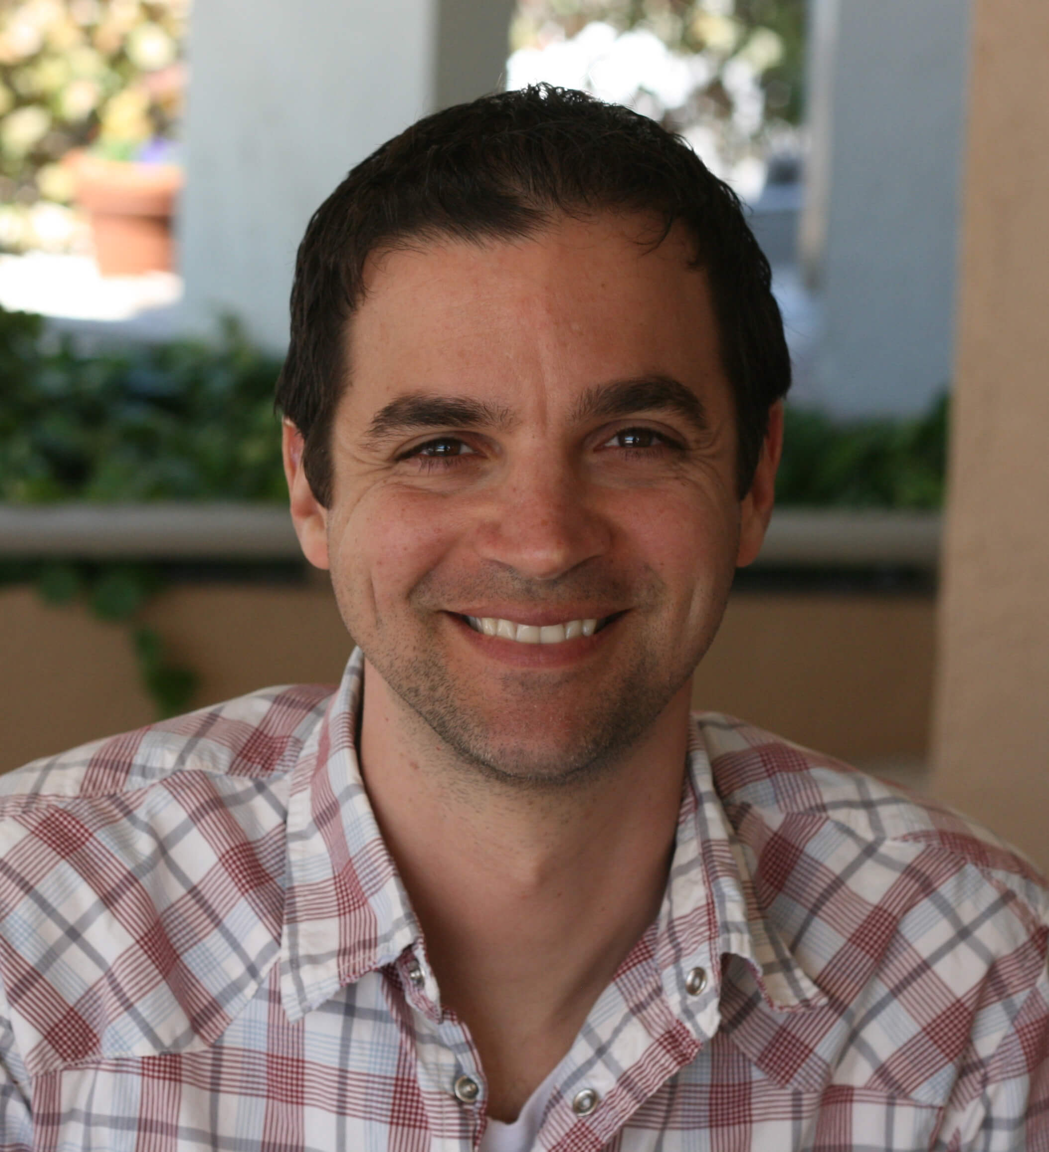

Rob Lauer
TJ VanToll
Director of Developer Relations
@RobLauer
Principal Developer Advocate
@TJVanToll

Slide 3
Complexity kills. It sucks the life out of developers, it makes products difficult to plan, build, and test.
Ray Ozzie – Blues CEO

Slide 4
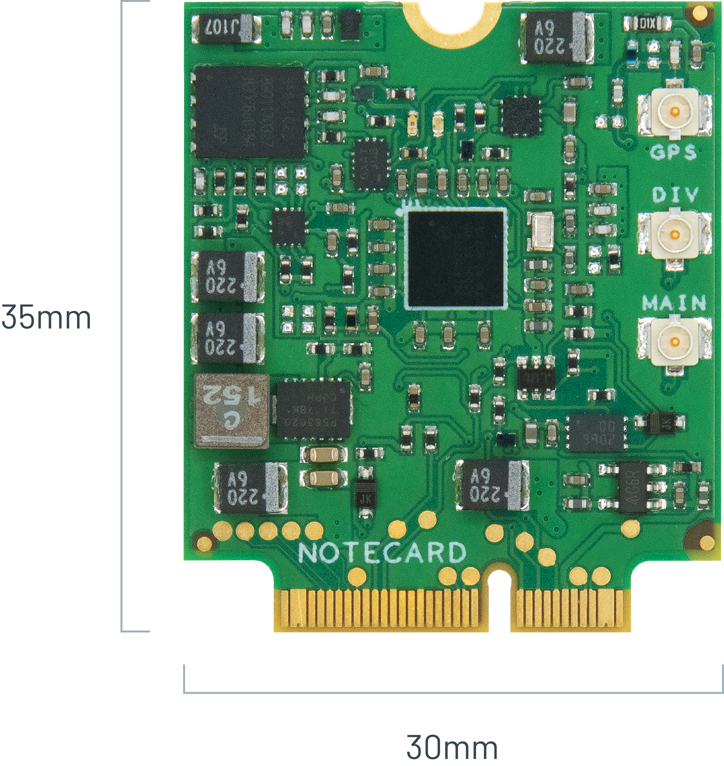
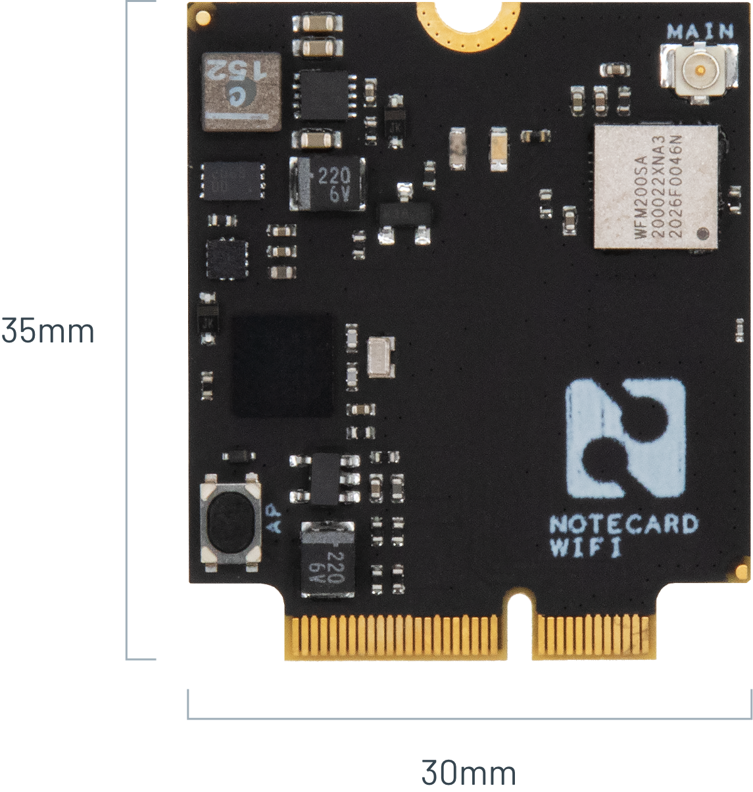
Today’s Agenda
Intro to the Blues Ecosystem
Hands-on Demonstration of Wireless IoT

Slide 5



Slide 7
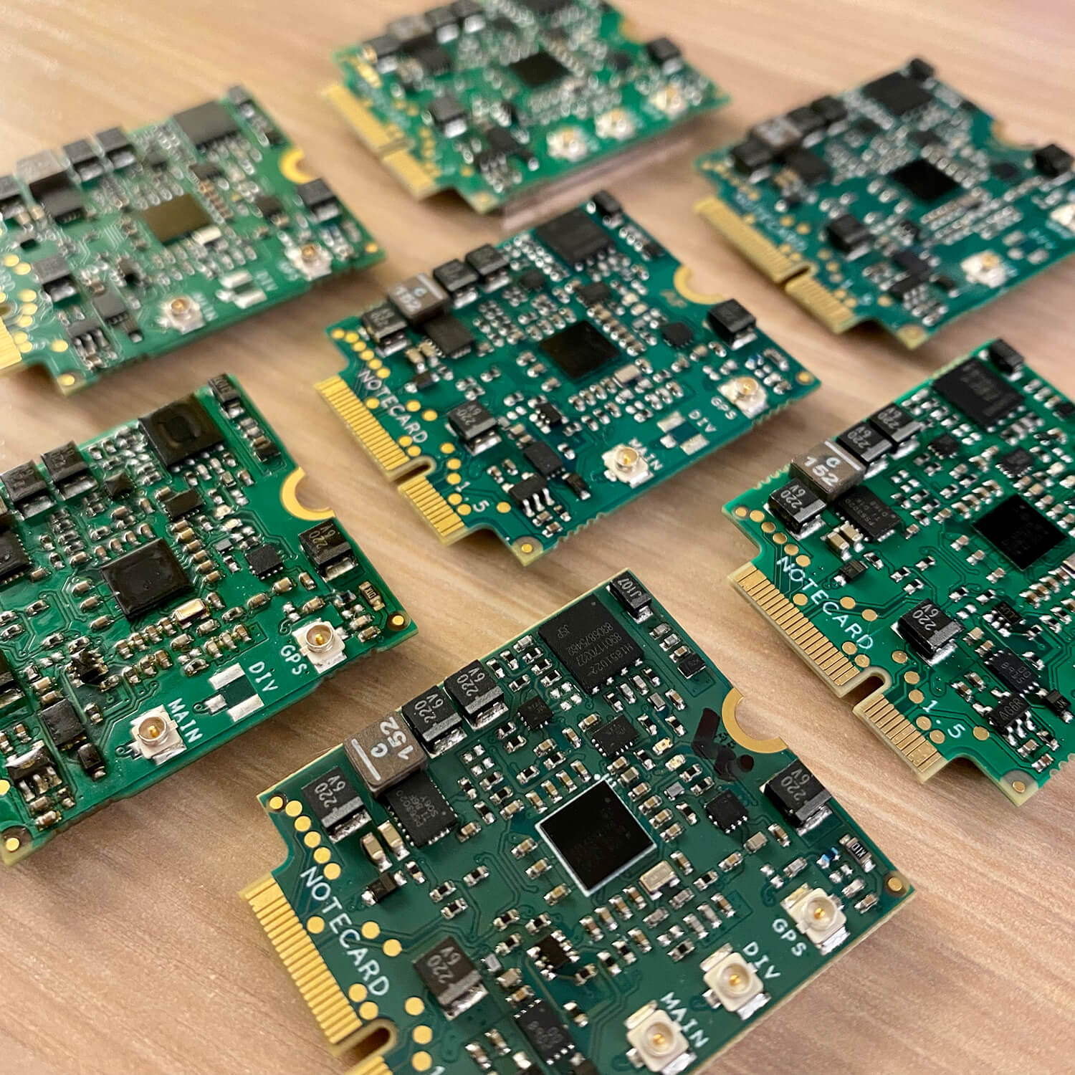
“Making wireless IoT easier for developers
and more affordable for all”

Slide 8

Easy for developers and affordable for all.
🔒 Securing your data from device to cloud
🔋 Building zero-config low-power hardware
👩‍💻 Providing an unmatched developer experience

Slide 9
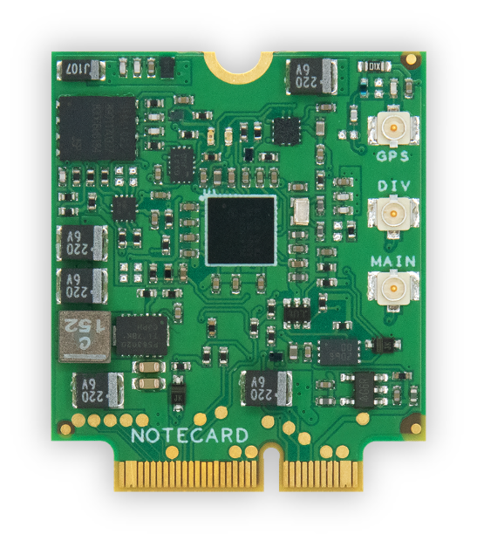

“Device-to-Cloud Data Pump”
🔒

Slide 10
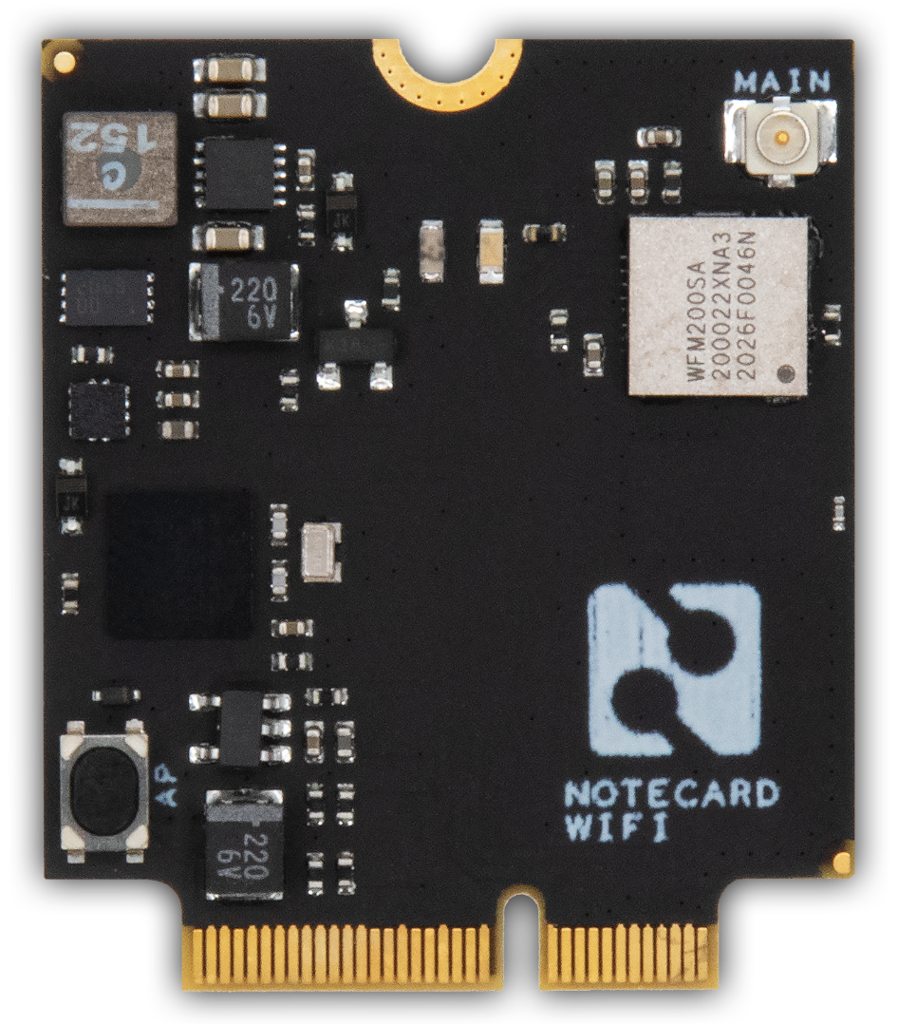
Notecard
Low-power system-on-module
Global cellular/GPS or Wi-Fi
500MB cell data + 10 years service
Dual SIM support
JSON-based API
Python, Go, Arduino, C/C++, Zephyr
NB-IoT, LTE-M, LTE Cat-1

Slide 11
Example: card.location API
Request
{ "req": "card.location" }
Response
{
"status": "GPS updated (58 sec, 41dB SNR, 9 sats),
"mode": "periodic",
"lat": 42.577600,
"lon": -70.871340,
"time": 1598554399
}

Slide 12
What don’t you need with Blues?
⛔️ SIM or Separate Mobile Plan
⛔️ AT Commands or Cellular Radio Management
⛔️ Custom Security Implementation
⛔️ Roll-Your-Own OTA Firmware Updates
⛔️ Power Management
⛔️ Custom Cloud Integration
⛔️ Certifications

Slide 13
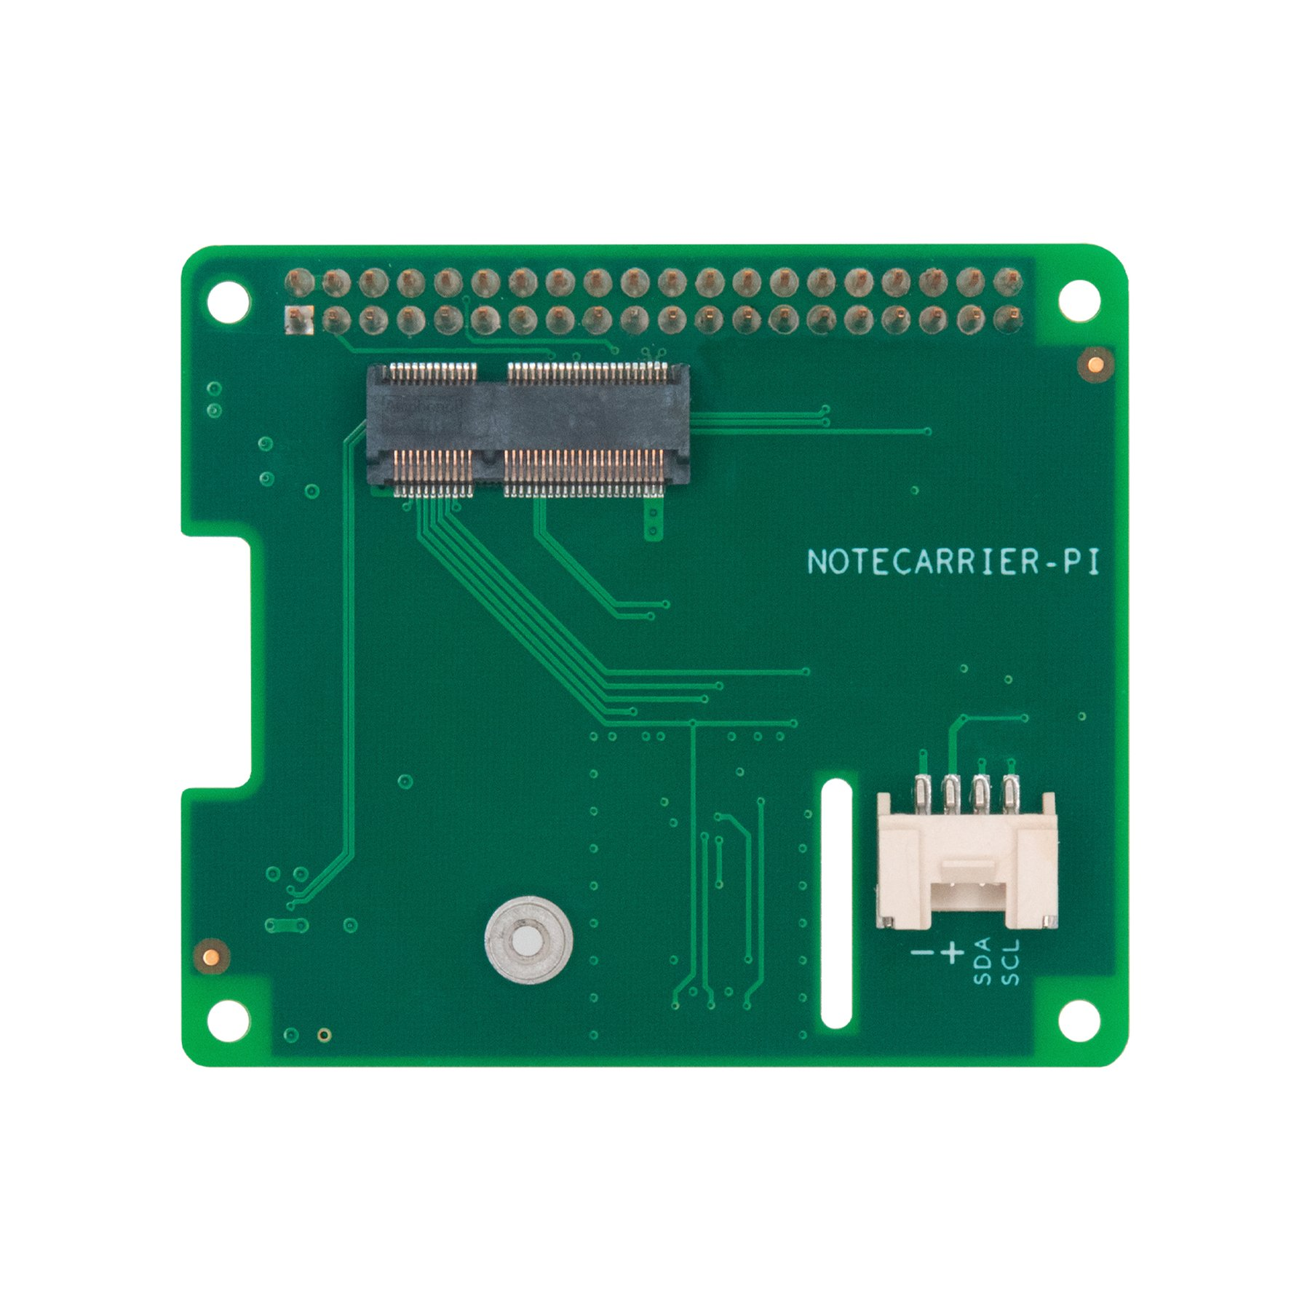
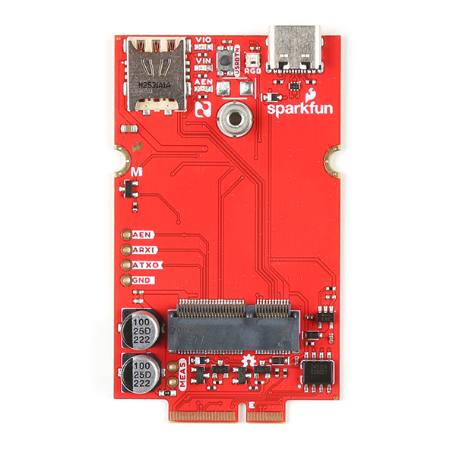
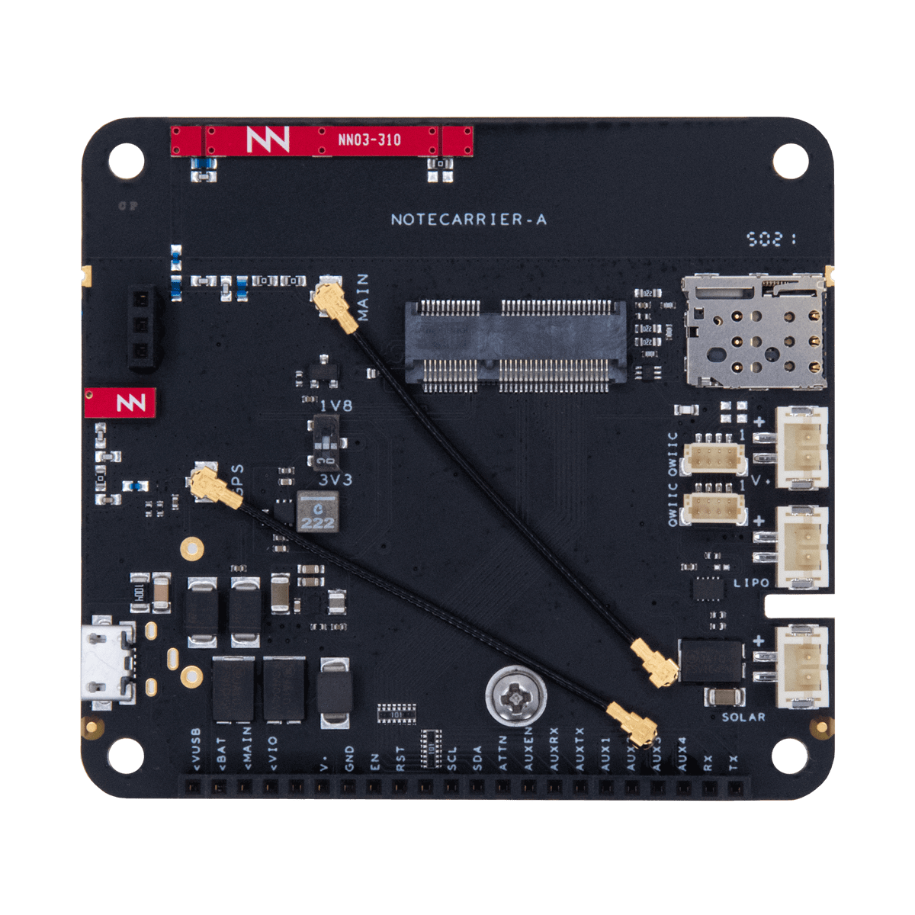
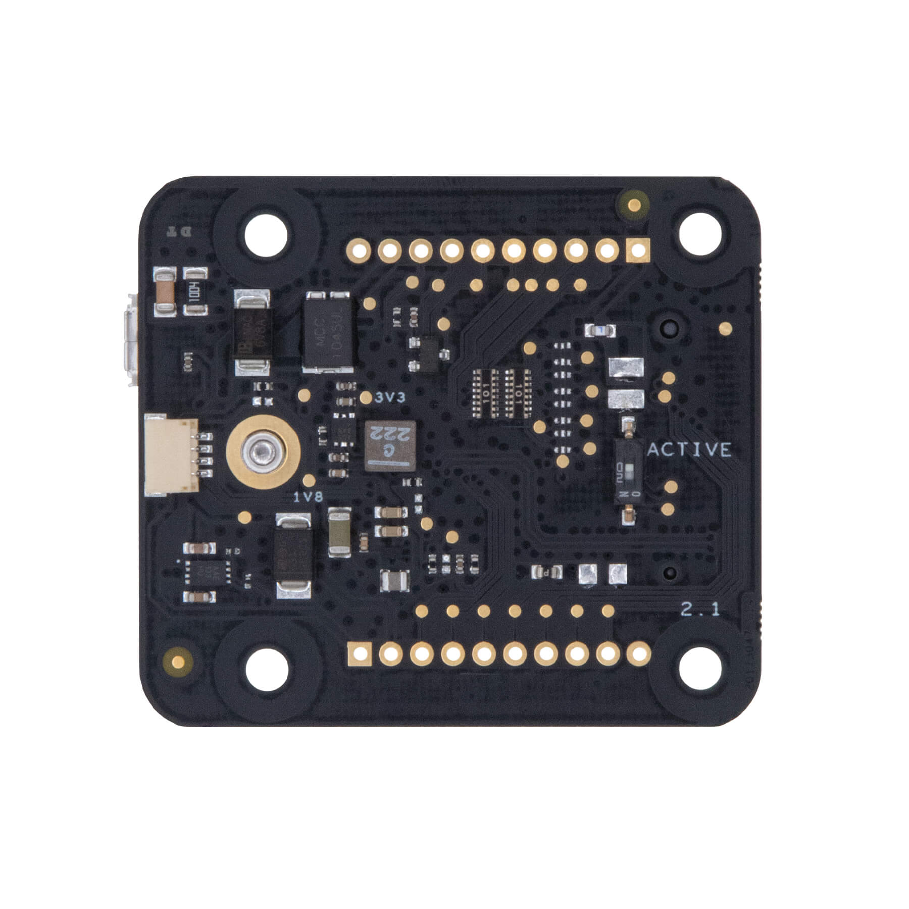
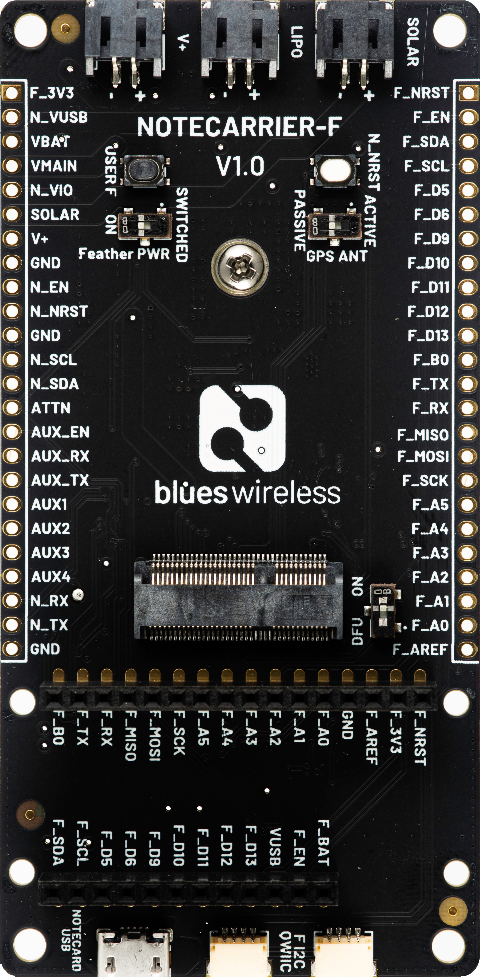
Notecarrier
Carrier boards for easy prototyping
Notecarrier for every scenario:
F – Feather-compatible socket
A – Any MCU, onboard antennas
B – Small form factor
Pi – Raspberry Pi SBC
SparkFun MicroMod Cellular Function

Slide 14
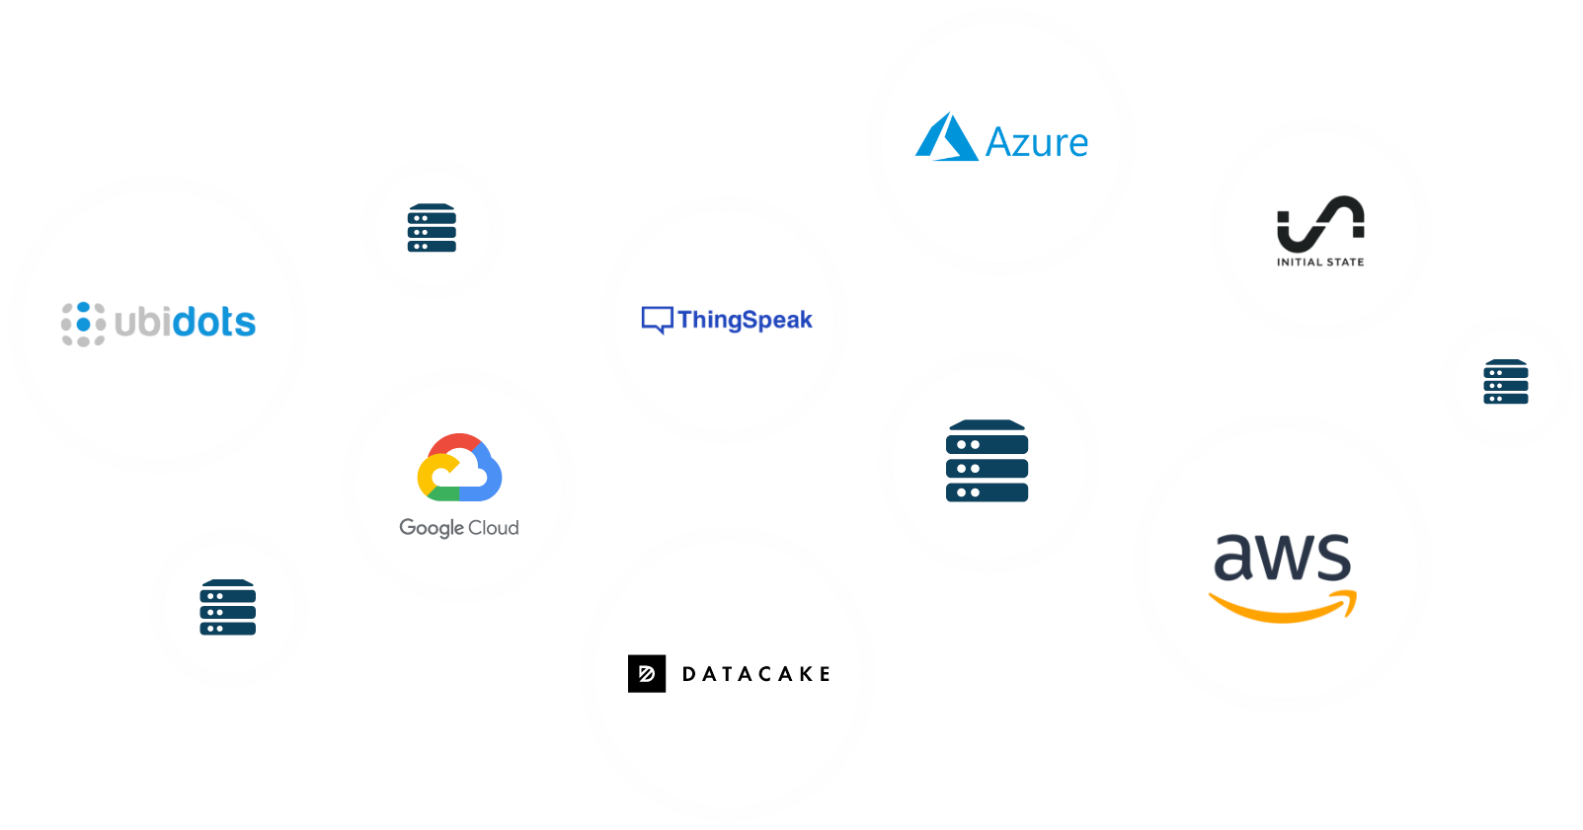
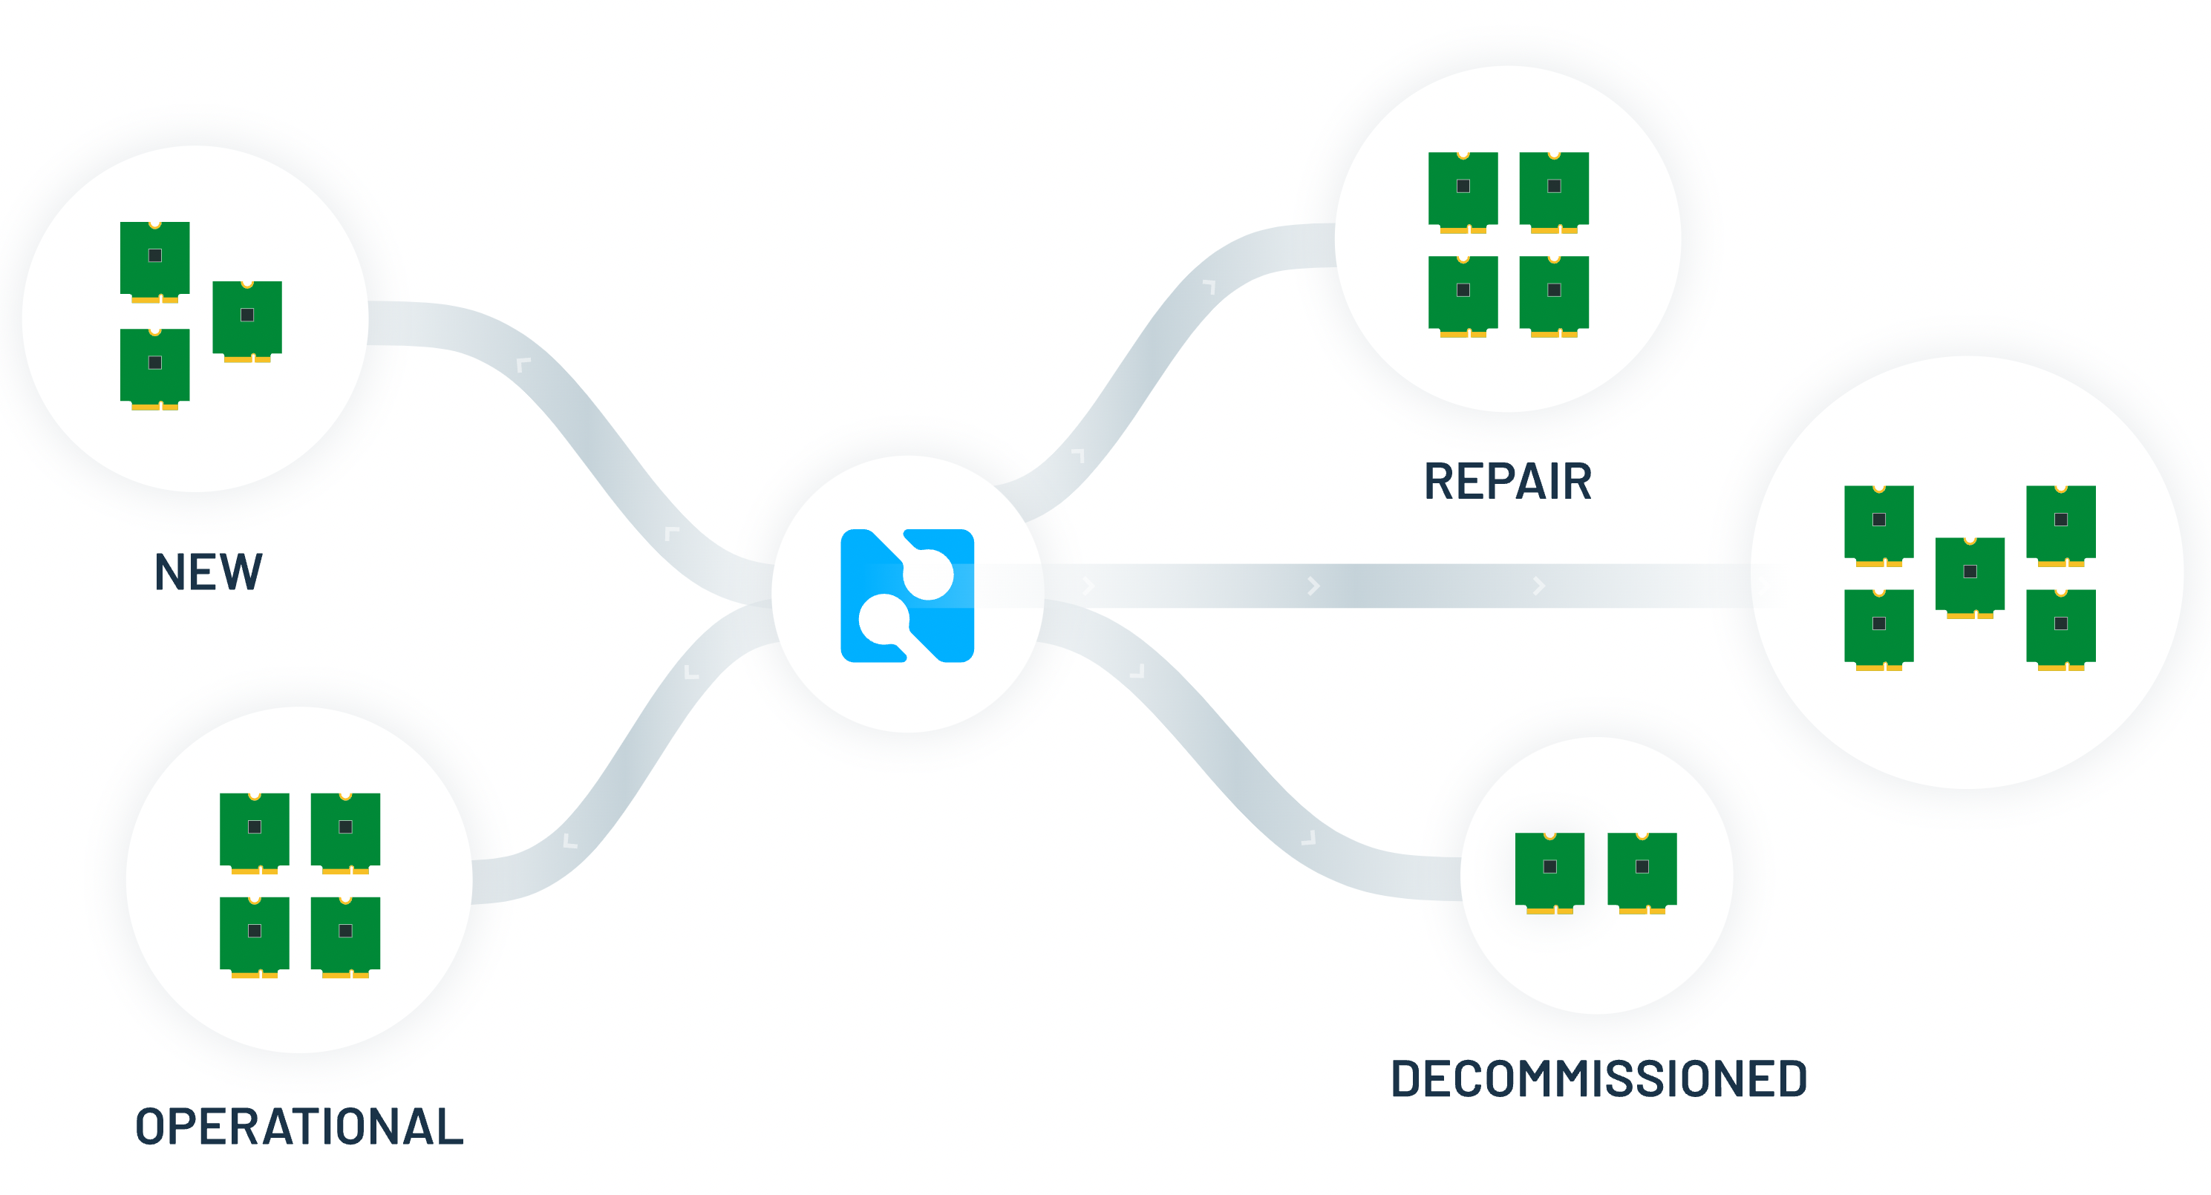

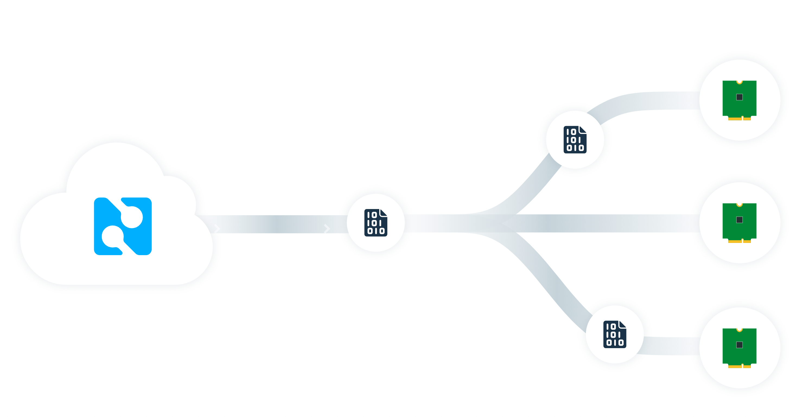
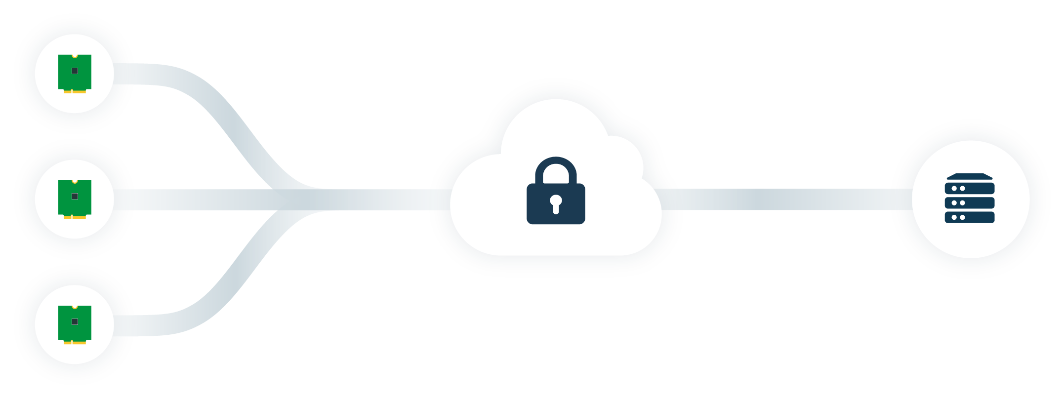
Notehub
Route data to any cloud app
Manage fleets of devices
OTA MCU/Notecard firmware updates
Secure communications

Slide 15
Notehub “Consumption Credits”
Only Pay for What You Use!
Billing Account “Topped Up” to 5,000 CCs Monthly
Notecard Purchase → 5,000 CCs

Slide 16
Notehub “Consumption Credits”
Send an Event to Notehub? FREE
Route an Event from Notehub to Cloud? 1 CC
Pull an Event via API? 1 CC
All other API requests? 0.001 CC

Slide 17
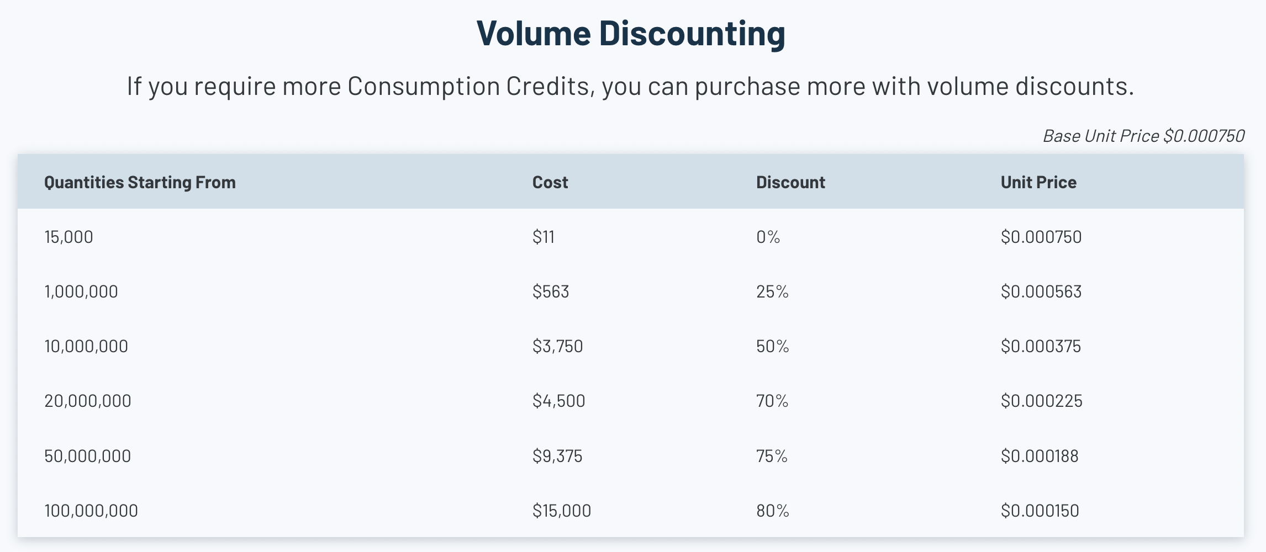
Notehub “Consumption Credits”

Slide 18
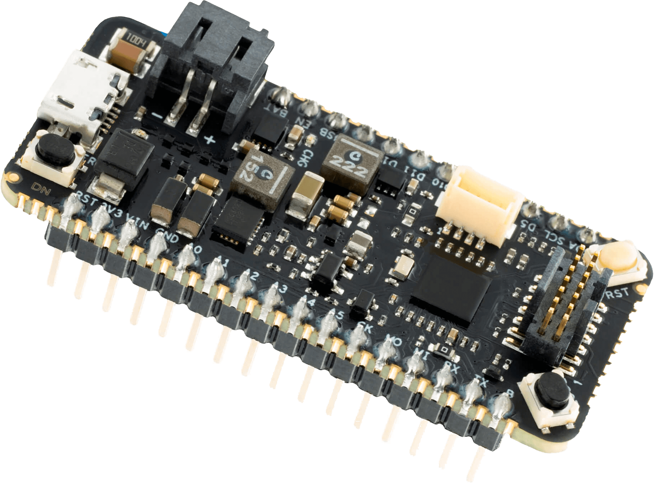
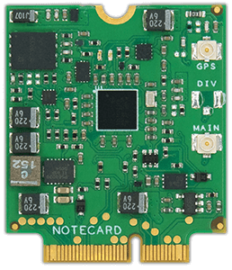


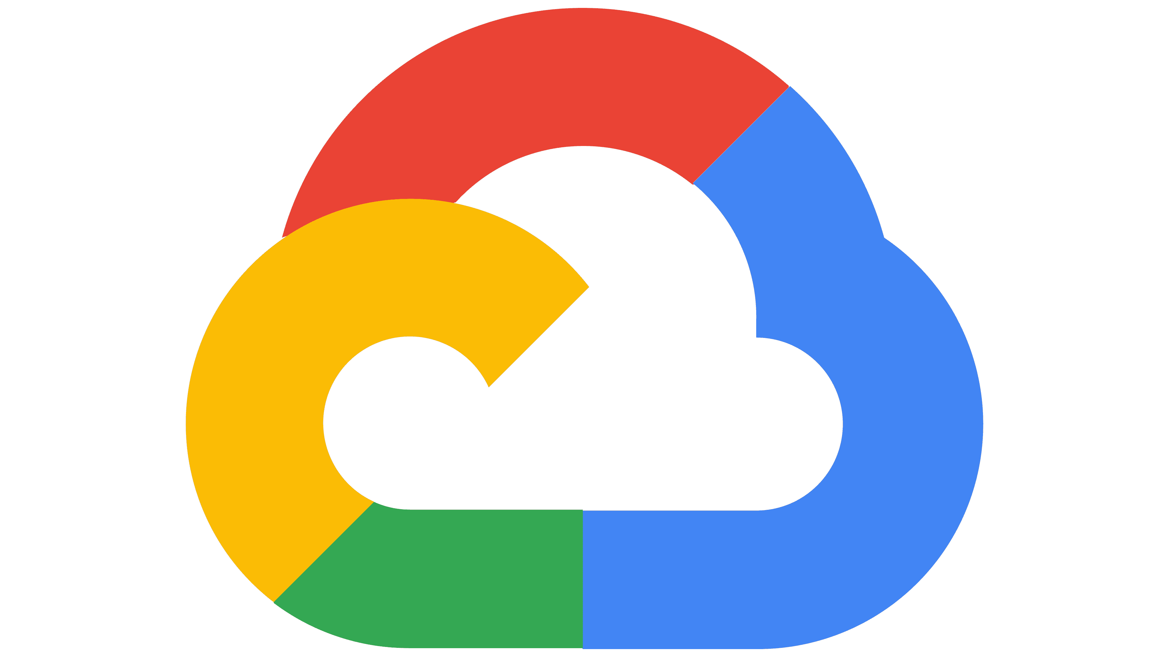
Outbound Communication (from Host to Cloud)
{JSON}
{JSON}
🔒📡️🔒
Your MCU/SBC
Your Sensors
Your Language
Cellular/Wi-Fi
Notecard
Blues
Notehub
Any Cloud
Arduino
C/C++
Python
JSON
J *req = NoteNewRequest("note.add");
JAddStringToObject(req, "file", "data.qo");
J *body = JCreateObject();
JAddNumberToObject(body, "temp", 27.3);
JAddItemToObject(req, "body", body);
NoteRequest(req);
{
"file": "data.qo",
"temp": 27.3,
"when": 1644268443,
"lat": 42.11,
"lon": -88.32
"device": "dev:89347"
}

Slide 19
Inbound Communication (from Cloud to Host)
{JSON}
{JSON}
🔒📡️🔒
Your MCU/SBC
Your Sensors
Your Language
Cellular/Wi-Fi
Notecard
Blues
Notehub
Any Cloud
Arduino
C/C++
Python
JSON
J *req = NoteNewRequest("note.get");
JAddStringToObject(req, "file", "data.qi");
JAddBoolToObject(req, "delete", true);
NoteRequest(req);
{
"file": "data.qi",
"sample_freq": 5,
"notify": true
}

Slide 20


When Does Blues Make Sense?
Need low-bandwidth cellular
Edge computing scenarios
Secure communications
Turnkey cloud integrations
Low-power is important
Wi-Fi replacement
Sub-millisecond latency
Video or high-res images

Slide 21
TJ VanToll
Principal Developer Advocate
@TJVanToll

Slide 22
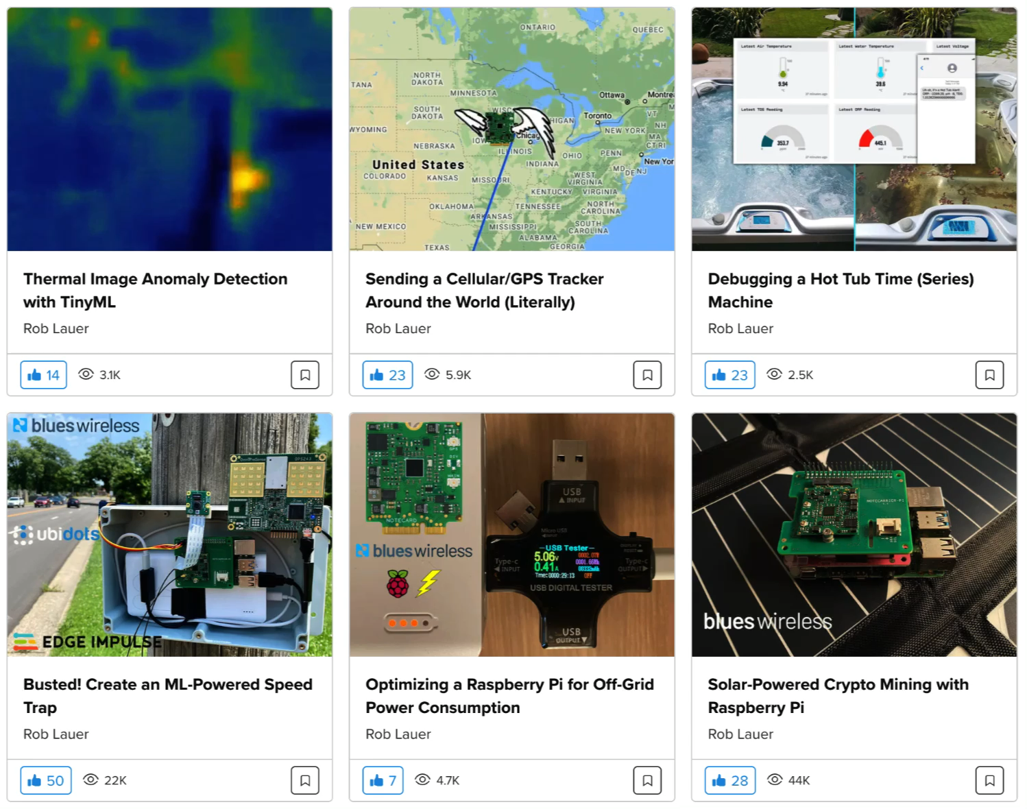
blues.dev/community/projects

Slide 23
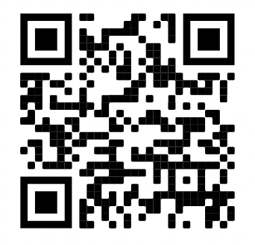
Thanks! (Time for Q&A)
🧑‍💻 blues.dev for Blues resources
🏁 15% off Starter Kits @ bit.ly/blues-get-started
🚀 “50 Ways to Accelerate Your IoT Project” @ bit.ly/accelerate-iot
Rob Lauer
TJ VanToll
Director of Developer Relations
Principal Developer Advocate
@RobLauer
@TJVanToll

